Slide 1
Employee Data Analysis using Excel
STUDENT NAME: Naveen.G
REGISTERNO:312200319/3F48D195CBF4CD5AD1947C84B63733C1
DEPARTMENT: B.COM COMMERCE
COLLEGE: S.I.V.E.T. COLLEGE

Slide 2
PROJECT TITLE
Employee Performance Analysis using Excel

Slide 3


AGENDA
Problem Statement
Project Overview
End Users
Our Solution and Proposition
Dataset Description
Modelling Approach
Results and Discussion
Conclusion
3/21/2024 Annual Review

Slide 4

PROBLEM STATEMENT
Create a detailed employee performance analysis using Excel by assessing key metrics like productivity, quality of work, and attendance. Aggregate data from various performance reviews and quantify it using relevant formulas and charts. Compare individual performance against department benchmarks. Identify trends and areas for improvement to support data-driven decision-making.

Slide 5

PROJECT OVERVIEW
The project aims to evaluate employee performance by collecting and analyzing data on key performance indicators (KPIs) such as productivity, quality, and rating using Excel. The analysis will involve data aggregation, visualization through charts, and comparison against set benchmarks. The goal is to identify performance trends and areas for improvement. This data-driven approach will support management in making informed decisions regarding employee development and resource allocation.

Slide 6

WHO ARE THE END USERS?
HR Managers
Team Leaders/Managers
Senior Management/Executives
Employees

Slide 7

OUR SOLUTION AND ITS VALUE PROPOSITION
Conditional Formatting: Missing
Filter: Remove
Formula: Performance
Pivot: Summary
Graph: Data Visualization

Slide 8
Dataset Description
Employee: Naan Mudhalvan Portal
26 features
9 features
Employee ID: Numerical Values
Name: Text
Employee Type
Performance level
Gender: Male and Female
Employee Rating: Numerical Values

Slide 9

THE "WOW" IN OUR SOLUTION
=IFS(Z9>=5,”VERY HIGH”,Z9>=4,”HIGH”,Z9>=3,”MED”,TRUE,”LOW”)
3/21/2024 Annual Review
9

Slide 10
MODELLING
Data Collection
Data Preparation
Visualization and Reporting
Analysis and Interpretation
Look for patterns in the data that might indicate high or low performance.
Compare performance across different teams, departments, or time periods.
Create interactive dashboards to visualize performance metrics and trends.
Generate detailed reports highlighting key insights, trends, and recommendations.
Ensure that data is accurate and complete. Address any inconsistencies or missing values.
Combine data from different sources to get a comprehensive view of performance.
Gather data from various sources such as performance reviews, KPIs, attendance records, and employee surveys.
10

Slide 11
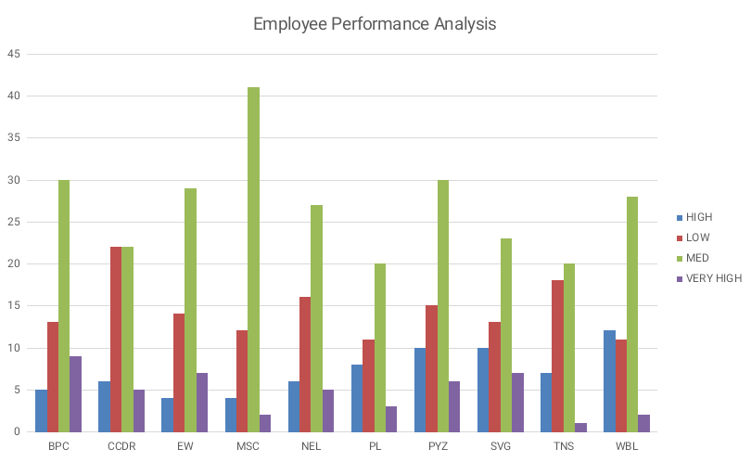
RESULTS
11

Slide 12
conclusion
The employee performance analysis using Excel by rating provides a comprehensive, data-driven approach to evaluating individual and team performance. By systematically assessing key metrics, organizations can identify strengths, address weaknesses, and align employee goals with overall business objectives. The analysis enables informed decision-making for HR managers and leaders, fostering a culture of continuous improvement and enhancing overall productivity. This method not only streamlines performance evaluations but also empowers employees to take ownership of their development and contribute more effectively to the organization's success.

